Slide 1
Treating the Black Death
Enquiry: How far did the Black Death change the Medieval World?
KS3 History - Lesson 2 of 4
Miss K Hillman

Slide 2
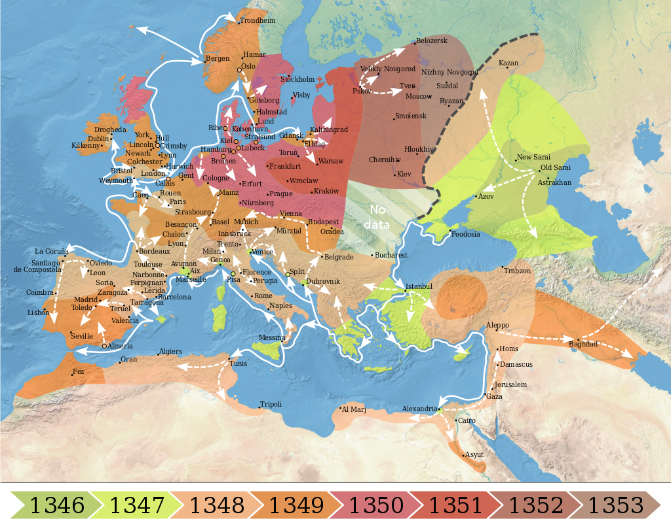
England: End of 1348
Map showing the Spread of the Black Death Across Europe 1346-1353,
France and Spain: Jan 1348
courtesy of WikiMedia Commons
Mediterranean Sea: Winter 1347

Slide 3
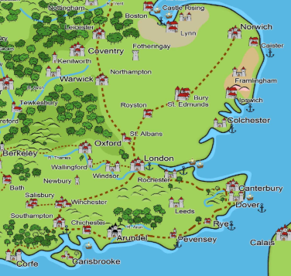
Walsham le Willows:
A Village in Crisis!
Walsham le Willows
No scientific knowledge of how diseases spread.
Only a fifth of people that developed buboes survived.
People turned to the church for guidance.
Credit: Medieval England and Wales map courtesy of timeref.com

Slide 4

How did the villagers of Walsham feel about the Black Death in 1348?
Option 1
Option 2
Calm - People knew how to stop the Black Death from spreading.
Worried - People had little knowledge of how to treat the Black Death.
Option 3
Option 4
Worried and confident - Some people were sure that England would stay safe whilst others worried about death rates.
Very panicked - People immediately started trying to run away from Walsham and escape the Black Death.

Slide 5
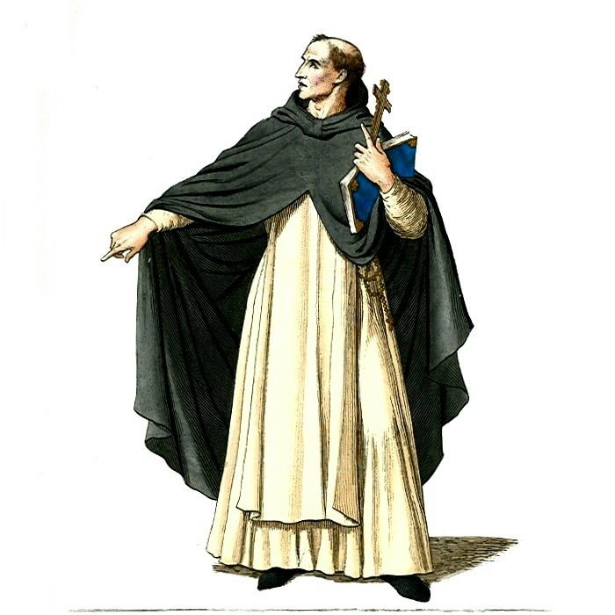
Walsham’s Plan to prevent the Black Death:
The Church taught that the Black Death was sent as a punishment from God.
People must confess all sins and ask for God’s forgiveness so that they could be spared.
Prayer time, visits and donations to the church all increased.
Credit: Medieval Priest, Friar or Monk courtesy of WikiCommons Media

Slide 6
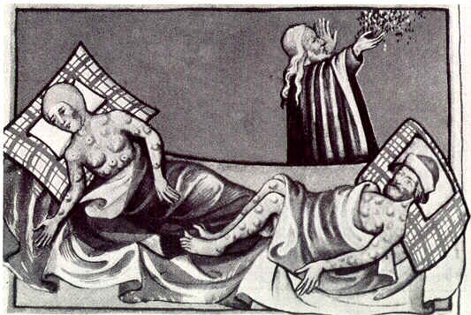
Walsham’s Plan to prevent the Black Death:
Poisonous Air believed to be a main cause.
Used strong smelling flowers and incense to create sweet air that would mask the poison.
Credit: Illustration of the Black Death from Toggenburg Bible (1411)courtesy of WikiCommons Media

Slide 7
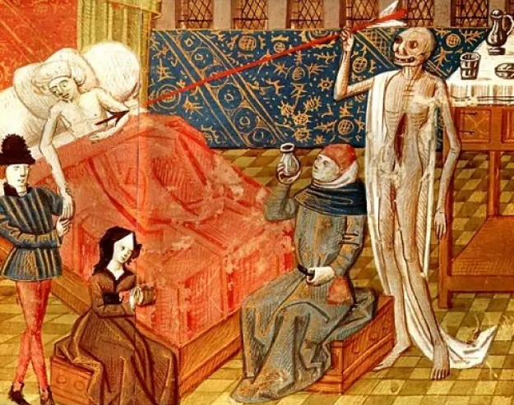
Walsham’s Plan to prevent the Black Death:
Villagers began to quarantine themselves.
Visitors from nearby towns were sent away.
Fewer amounts of people attended funerals or visited the sick.
Black Death XV courtesy of WikiCommons Media

Slide 8
Pause: Which methods did Walsham villagers use to prevent the Black Death?
Villagers decided to confess all sins to God in hope of forgiveness.
People would visit one another regularly to check on how they were doing.
Holding flowers to your nose and breathing incense was thought to stop the poisonous air from infecting you.
New visitors were sent away and families isolated from each other.
Villagers would attend the church but refused to make any donations.
Many people decided to go and get a vaccine to prevent the Black Death.

Slide 9
Pause: Which methods did Walsham villagers use to prevent the Black Death?
Villagers decided to confess all sins to God in hope of forgiveness.
People would visit one another regularly to check on how they were doing.
Holding flowers to your nose and breathing incense was thought to stop the poisonous air from infecting you.
New visitors were sent away and families isolated from each other.
Villagers would attend the church but refused to make any donations.
Many people decided to go and get a vaccine to prevent the Black Death.

Slide 10
Comprehension Questions
What did people believe was the main cause of the Black Death?
How would people try to stop poisonous air from infecting them with the disease?
What happened to people visiting Walsham that came from infected areas?
How did the villagers of Walsham prove their religious devotion to try and escape the Black Death?
Why could villagers not go and visit friends or family that were ill?

Slide 11

Pause the video, read the slides on the next page and answer the comprehension questions.
Resume once you’re finished

Slide 12
Comprehension Questions - Answers
What did people believe was the main cause of the Black Death?
Acceptable Answer:
Punishment from God.
Good Answer:
People mainly believed that the Black Death was sent by God as a punishment for people’s sins.

Slide 13
Comprehension Questions - Answers
2. How would people try to stop poisonous air from infecting them with the disease?
Acceptable Answer:
By smelling flowers or incense.
Good Answer:
To stop the spread of the Black Death people would hold flowers to their nose or burn incense to prevent smelling the poisonous air that could infect them with the disease..

Slide 14
Comprehension Questions - Answers
3. What happened to people visiting Walsham that came from infected areas?
Acceptable Answer:
They were sent away, sometimes villagers would throw stones at them.
Good Answer: Walsham wanted to stay isolated from the Black Death so any visitor who was found to be from an infected area were treated very harshly. They would be sent away, sometimes using violence as stones were thrown at them.

Slide 15
Comprehension Questions - Answers
4. How did the villagers of Walsham prove their religious devotion to try and escape the Black Death?
Acceptable Answer: By praying, giving donations to the church and going on pilgrimages.
Good Answer: To escape the Black Death people tried to prove to God they were a good Christian that did not need punishing. They would pray for forgiveness, give money to the church, and go on pilgrimages to holy sites.

Slide 16
Comprehension Questions - Answers
5. Why could villagers not go and visit friends or family that were ill?
Acceptable Answer:
Because they could get infected.
Good Answer: Villagers did not visit the sick because they believed they could catch the disease if the victim looked, touched or breathed on them. Many villagers isolated themselves to try and prevent the disease spreading further.

Slide 17
Enquiry Question
How far did the Black Death change the Medieval World?

Slide 18
Pause here. By learning about how Walsham treated the Black Death, has Medieval life changed any further? Use the pictures to help.
Last lesson:
Increased death rate
Quarantine
New warfare tactics
Sentence starters.
When villagers started to try and prevent the Black Death from spreading their life changed because….

Slide 19
Pause here. By learning about how Walsham treated the Black Death, has Medieval life changed any further? Use the pictures to help.
Changes from last lesson:
Increased death rate
Quarantine
New warfare tactics
Changes in this lesson:
Increased engagement with the church (confession, donations and pilgrimages).
Homes filled with strong smells (flowers and incense)
Stricter quarantine, no outside visitors and less interaction between families.

Slide 20
Share your work with Oak National
If you'd like to, please ask your parent or carer to share your work on Instagram, Facebook or Twitter tagging @OakNational and #LearnwithOak

